Slide 1

1
Housing Data Predictions Linear Regression and KNN
Jason Tang
03/18/2023

Slide 2

2
_{CONTENTS}
Use case: Luxury Retail development
House Data Preparation
KNN
Linear Regression
Conclusion

Slide 3
3
01
PART ONE
Luxury Retail development

Slide 4

4
Luxury retail development is an important part of the economy, but making informed decisions about where and how to develop luxury retail spaces can be challenging. In this project, we are using data to help inform these decisions
To achieve this goal, we will be using a dataset that contains information on luxury retail properties in a major city(Arizona), including the sold price, longitude, and latitude of each property. Our analysis will focus on using these variables to identify areas that are likely to have high demand for luxury retail development
Dataset we will be using contains 5000 Rows of data and contains 16 features, we have cleaned the data and kept what is valuable to our analysis and our model.

Slide 5
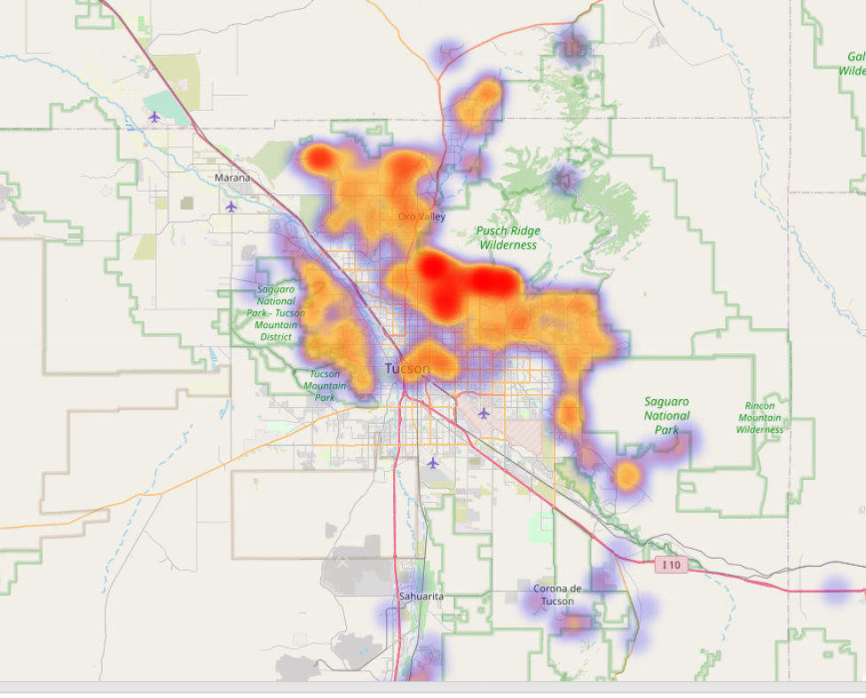
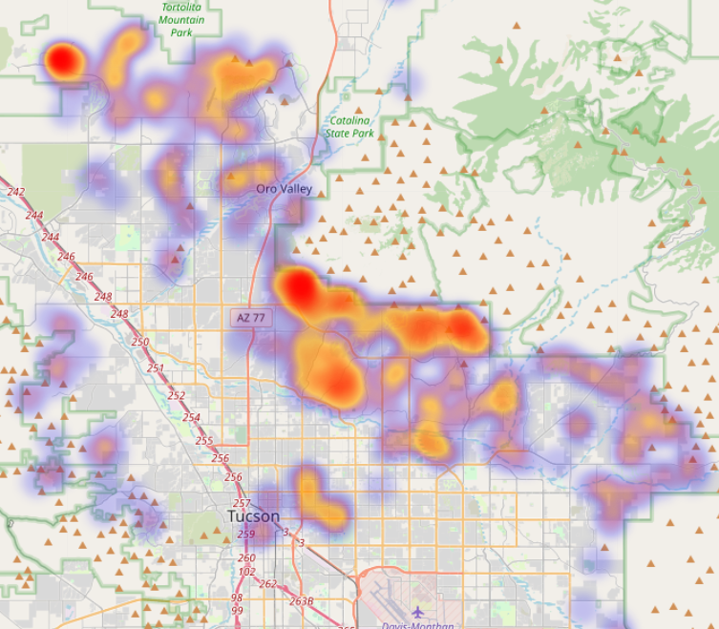
5
Potential areas for Luxury retail development
We can see that most of the high value houses are not so close to the center of Tucson.
.
Most Houses are in Tucson, Arizona。.

Slide 6
6
02
PART TWO
Prepare the Dataset

Slide 7
7
Our house dataset is in CSV format and has been cleaned.
Data cleaning: dropping unnecessary 0s and Nones, select the features has strong correlation to sold price, and important features that is relevant to use case
30%
40%
Check the shape and transfer it to array using numpy
50%
Now we can use algorithms

Slide 8
8
03
PART THREE
KNN(k- nearest neighbors)

Slide 9
9
KNN can be particularly useful for house data, where there may be many features that can impact the price of a house
The KNN Classifier is a non-parametric algorithm that works by finding the k closest images in the training set to the input image

Slide 10
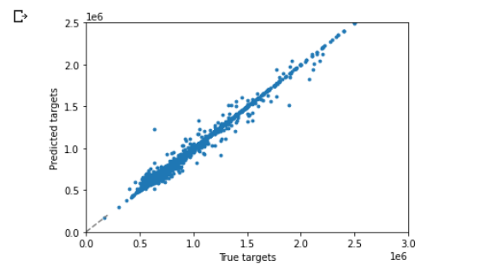
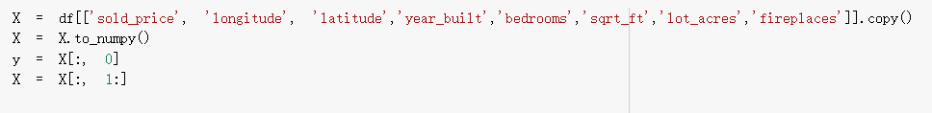
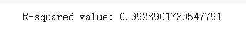
10
KNN with K=5
Here I have selected the features that’s has the strongest correlation and are important to our use case
Fit line close to diagonal.
After I trained the model and evaluated the model, I got 0.99 R – squared value.

Slide 11
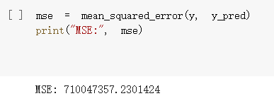
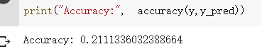
11
KNN with K=5
This is suggesting the model is overfitting and doesn't perform really well

Slide 12
12
04
PART FOUR
Linear regression

Slide 13
13
Linear regression is a powerful tool for modeling relationships between variables and making predictions.
Linear regression is a statistical model used to examine the relationship between a dependent variable and one or more independent variables
However, it assumes that the relationship between the dependent variable and the independent variables is linear. If this assumption is not met, it won’t perform well.

Slide 14
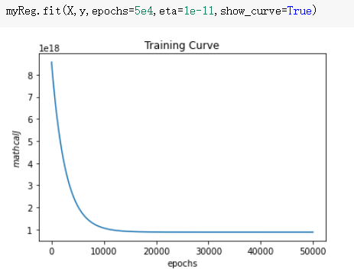
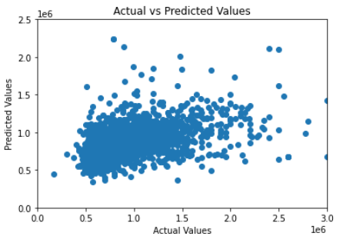
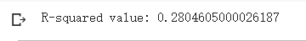
14
Linear Regression Model
This shows us our model is not overfitting
Diagonal fit line

Slide 15
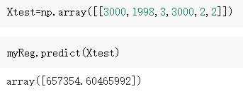
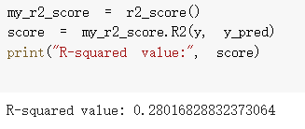
15
Linear Regression Model
Usable model and prediction is respectable

Slide 16
16
Conclusion
01
Advantage of using KNN on house data is its simplicity. KNN does not require any assumptions about the underlying distribution of the data and can be used for both linear and nonlinear relationships between the features and the target variable
02
Our house data, where the relationship between features (such as square footage, number of bedrooms, and location) and the target variable (such as house price) may be nonlinear
03
KNN Did not achieve a good performance on this house dataset compared to Linear regression which has good and respectful performance

Slide 17
17
Thank you

